Slide 1
UMass Lowell Computer Science 91.404
Analysis of Algorithms
Prof. Karen Daniels
Spring, 2008
Final Review

Slide 2
Review of Key Course Material

Slide 3



What’s It All About?
Algorithm:
  steps for the computer to follow to solve a problem
Problem Solving Goals:
  recognize structure of some common problems
  understand important characteristics of algorithms to solve common problems
  select appropriate algorithm & data structures to solve a problem
  tailor existing algorithms
  create new algorithms

Slide 4

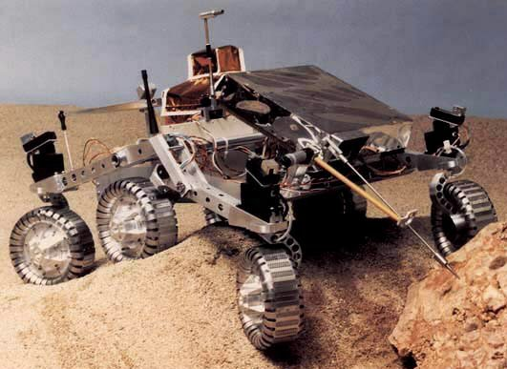
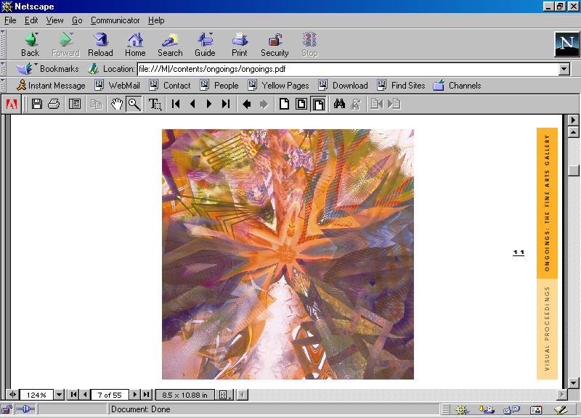
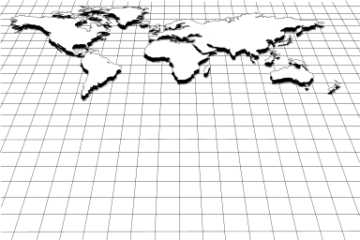


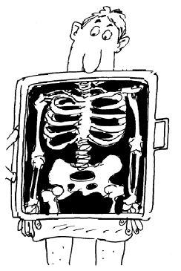

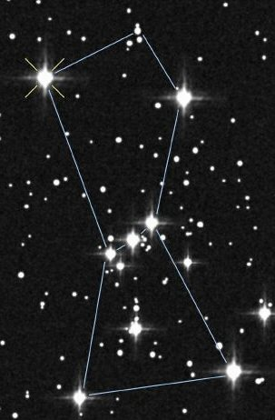
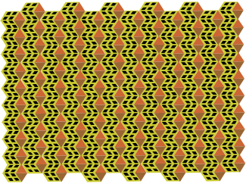
Some Algorithm Application Areas
Robotics
Geographic
Information Systems
Bioinformatics
Design
Analyze
Algorithms
Telecommunications
Apply
Computer Graphics
Medical Imaging
Astrophysics

Slide 5
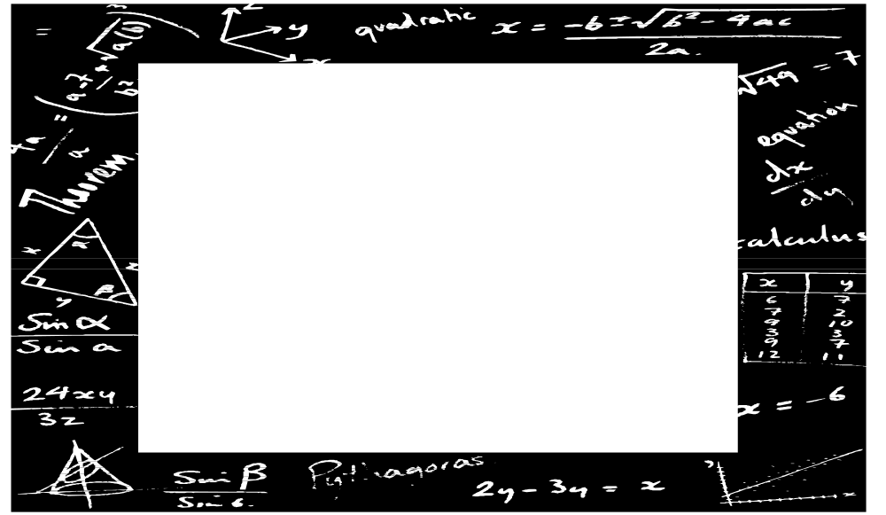
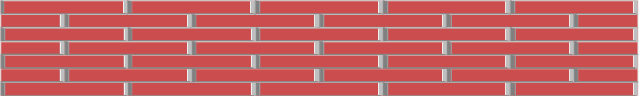
Tools of the Trade
Algorithm Design Patterns such as:
  binary search
  divide-and-conquer
  randomized
Data Structures such as:
  trees, linked lists, stacks, queues, hash tables, graphs, heaps, arrays
MATH
Summations
Proofs
Sets
Growth of Functions
Probability
Recurrences

Slide 6
Discrete Math Review
Growth of Functions, Summations, Recurrences, Sets, Counting, Probability

Slide 7
Topics
Discrete Math Review :
  Sets, Basic Tree & Graph concepts
  Counting: Permutations/Combinations
  Probability: Basics, including Expectation of a Random Variable
  Proof Techniques: Induction
Basic Algorithm Analysis Techniques:
  Asymptotic Growth of Functions
  Types of Input: Best/Average/Worst
  Bounds on Algorithm vs. Bounds on Problem
  Algorithmic Paradigms/Design Patterns:
    Divide-and-Conquer, Randomized
  Analyze pseudocode running time to form summations &/or recurrences

Slide 8
What are we measuring?
Some Analysis Criteria:
  Scope
    The problem itself?
    A particular algorithm that solves the problem?
  “Dimension”
    Time Complexity? Space Complexity?
  Type of Bound
    Upper? Lower? Both?
  Type of Input
    Best-Case? Average-Case? Worst-Case?
  Type of Implementation
    Choice of Data Structure

Slide 9
Function Order of Growth
1
lglg(n)
lg(n)
n
n lg(n)
n lg²(n)
n²
n⁵
2^{n}
know how to order functions asymptotically
(behavior as n becomes large)
O( ) upper bound
Ω( ) lower bound
Θ( ) upper & lower bound
shorthand for inequalities
know how to use asymptotic complexity notation
to describe time or space complexity

Slide 10
Types of Algorithmic Input
Best-Case Input: of all possible algorithm inputs of size n, it generates the “best” result
for Time Complexity: “best” is smallest running time
Best-Case Input Produces Best-Case Running Time
provides a lower bound on the algorithm’s asymptotic running time
(subject to any implementation assumptions)
for Space Complexity: “best” is smallest storage
Average-Case Input
Worst-Case Input
these are defined similarly
Best-Case Time <= Average-Case Time <= Worst-Case Time

Slide 11
Bounding Algorithmic Time
(using cases)
Using “case” we can discuss lower and/or upper bounds on:
best-case running time or average-case running time or worst-case running time
1
lglg(n)
lg(n)
n
n lg(n)
n lg²(n)
n²
n⁵
2^{n}
T(n) = Ω(1)
very loose bounds are not very useful!
T(n) = Ο(2^{n})
Worst-Case time of T(n) = Ο(2^{n}) tells us that worst-case inputs cause the algorithm to take at most exponential time (i.e. exponential time is sufficient).
But, can the algorithm every really take exponential time? (i.e. is exponential time necessary?)
If, for arbitrary n, we find a worst-case input that forces the algorithm to use exponential time, then this tightens the lower bound on the worst-case running time. If we can force the lower and upper bounds on the worst-case time to match, then we can say that, for the worst-case running time, T(n) = Θ(2^{n} ) (i.e. we’ve found the minimum upper bound, so the bound is tight.)

Slide 12
Bounding Algorithmic Time
(tightening bounds)
for example...
1
lglg(n)
lg(n)
n
n lg(n)
n lg²(n)
n²
n⁵
2^{n}
T_{B} (n) = Ο(n)
T_{W} (n) = Ω(n²)
T_{W} (n) = Ο(2^{n})
T_{B}(n) = Ω(1)
1st attempt
1st attempt
1st attempt
1st attempt
T_{B}(n) = Θ(n)
T_{W}(n) = Θ(n²)
2nd attempt
2nd attempt
Algorithm Bounds
Here we denote best-case time by T_{B}(n); worst-case time by T_{W}(n)

Slide 13
Approach
Explore the problem to gain intuition:
  Describe it: What are the assumptions? (model of computation, etc...)
  Has it already been solved?
  Have similar problems been solved? (more on this later)
  What does best-case input look like?
  What does worst-case input look like?
Establish worst-case upper bound on the problem using an algorithm
  Design a (simple) algorithm and find an upper bound on its worst-case asymptotic running time; this tells us problem can be solved in a certain amount of time. Algorithms taking more than this amount of time may exist, but won’t help us.
Establish worst-case lower bound on the problem
Tighten each bound to form a worst-case “sandwich”
1
n
n²
n³
n⁴
n⁵
2^{n}
increasing worst-case asymptotic running time as a function of n

Slide 14
Know the Difference!
Strong Bound: This worst-case lower bound on the problem holds for every algorithm that solves the problem and abides by our problem’s assumptions.
Weak Bound: This worst-case upper bound on the problem comes from just considering one algorithm. Other, less efficient algorithms that solve this problem might exist, but we don’t care about them!
1
No algorithm for the problem exists that can solve it for worst-case inputs in less than linear time .
n
n⁵
An inefficient algorithm for the problem might exist that takes this much time, but would not help us.
2^{n}
worst-case bounds
on problem
Both the upper and lower bounds are probably loose (i.e. probably can be tightened later on).

Slide 15
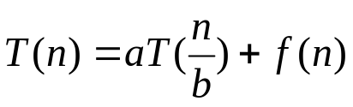
Master Theorem
Master Theorem :
Let with a > 1 and b > 1 .
Then :
Case 1: If f(n) = O ( n ^{(log} _{b} ^{a) - ε} ) for some ε > o
then T ( n ) = Θ ( n ^{log} _{b} ª )
Case 2: If f (n) = Θ (n ^{log} _{b} ª )
then T ( n ) = Θ (n ^{log} _{b} ª * log n )
Case 3: If f ( n ) = Ω (n ^{(log} _{b}^{a) + ε} ) for some ε > o and if
f( n/b) < c f ( n ) for some c < 1 , n > N₀
then T ( n ) = Θ ( f ( n ) )
Use ratio test to distinguish between cases:
f(n)/ n ^{log} _{b} ª
Look for “polynomially larger” dominance.

Slide 16
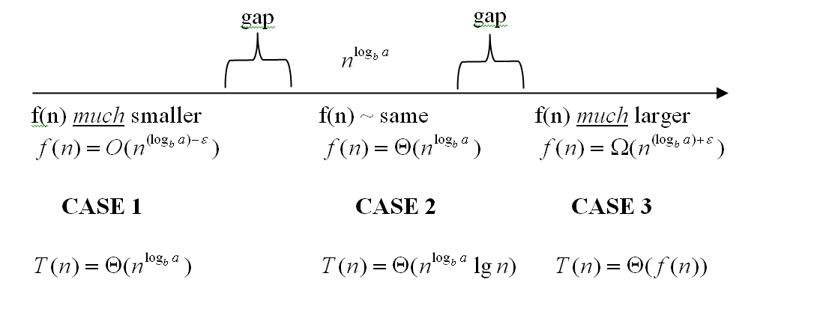
Master Theorem

Slide 17
CS Theory Math Review Sheet
The Most Relevant Parts...
p. 1
  O, Θ, Ω definitions
  Series
  Combinations
p. 2 Recurrences & Master Method
p. 3
  Probability
  Factorial
  Logs
  Stirling’s approx
p. 4 Matrices
p. 5 Graph Theory
p. 6 Calculus
  Product, Quotient rules
  Integration, Differentiation
  Logs
p. 8 Finite Calculus
p. 9 Series
Math fact sheet (courtesy of Prof. Costello) is on our web site.

Slide 18
Sorting
Chapters 6-9
Heapsort, Quicksort, LinearTime-Sorting

Slide 19
Topics
Sorting: Chapters 6-8
  Sorting Algorithms:
    [Insertion & MergeSort)], Heapsort, Quicksort, LinearTime-Sorting
  Comparison-Based Sorting and its lower bound
  Breaking the lower bound using special assumptions
  Tradeoffs: Selecting an appropriate sort for a given situation
    Time vs. Space Requirements
    Comparison-Based vs. Non-Comparison-Based

Slide 20
Heaps & HeapSort
Structure:
  Nearly complete binary tree
  Convenient array representation
HEAP Property: (for MAX HEAP)
  Parent’s label not less than that of each child
Operations: strategy worst-case run-time
  HEAPIFY: swap down O(h) [h= ht]
  INSERT: swap up O(h)
  EXTRACT-MAX: swap, HEAPIFY O(h)
  MAX: view root O(1)
  BUILD-HEAP: HEAPIFY O(n)
  HEAP-SORT: BUILD-HEAP, HEAPIFY Θ(nlgn)
16
14
10
8
7
9
3
2
4
1
16
14
10
8
7
9
3
2
4
1
1 2 3 4 5 6 7 8 9 10
Notes:
At the end of last week in lecture we introduced this new part of the course on SORTING and we began discussing Chapter 7 on HEAPs.
From a structural point of view, we defined a heap as a nearly complete binary tree. This structure allows us to conveniently represent a HEAP in an array because it is easy to find the position in the array of each node’s parent and children.
The other part of a HEAP’s definition relates to the values of node labels. In a MAX-HEAP, the value of each node is not smaller than the value of either child. Similarly, in a MIN-HEAP, the value of each node is not larger than the value of either child. We call this relationship the HEAP PROPERTY. Note that it provides a guarantee about the relative label sizes for parents with respect to children. However, there is no guarantee about the relative sizes of sibling labels with respect to each other.

Slide 21


QuickSort
left partition
right partition
9
7
3
2
4
1
16
14
10
11
Divide-and-Conquer Strategy
  Divide: Partition array
  Conquer: Sort recursively
  Combine: No work needed
Asymptotic Running Time:
  Worst-Case: Θ(n²) (partitions of size 1, n-1)
  Best-Case: Θ(nlgn) (balanced partitions of size n/2)
  Average-Case: Θ(nlgn) (balanced partitions of size n/2)
      Randomized PARTITION
        selects partition element randomly
        imposes uniform distribution
Does most of the work on the way down (unlike MergeSort, which does most of work on the way back up (in Merge).
Recursively sort left partition
Recursively sort right partition
PARTITION
Notes:
At the end of last week in lecture we introduced this new part of the course on SORTING and we began discussing Chapter 7 on HEAPs.
From a structural point of view, we defined a heap as a nearly complete binary tree. This structure allows us to conveniently represent a HEAP in an array because it is easy to find the position in the array of each node’s parent and children.
The other part of a HEAP’s definition relates to the values of node labels. In a MAX-HEAP, the value of each node is not smaller than the value of either child. Similarly, in a MIN-HEAP, the value of each node is not larger than the value of either child. We call this relationship the HEAP PROPERTY. Note that it provides a guarantee about the relative label sizes for parents with respect to children. However, there is no guarantee about the relative sizes of sibling labels with respect to each other.

Slide 22
Comparison-Based Sorting
Time:
BestCase AverageCase WorstCase
Algorithm:
InsertionSort
  Θ(n) Θ(n²)
MergeSort
  Θ(n lg n) Θ(n lg n) Θ(n lg n)
QuickSort
  Θ(n lg n) Θ(n lg n) Θ(n²)
HeapSort
  Θ(n lg n)* Θ(n lg n)
(*when all elements are distinct)
In algebraic decision tree model, comparison-based sorting of n items requires Ω(n lg n) worst-case time.
To break the lower bound and obtain linear time, forego direct value comparisons and/or make stronger assumptions about input.

Slide 23
Non-Comparison-Based Sorting and Hybrid Sorting
Comparison-Based Sorting: Insertion-Sort, Merge-Sort, Heap-Sort, Quick-Sort
Ω(nlgn)
Non-Comparison-Based Sorting and Hybrid Sorting
Counting-Sort: Stable sort. Worst-case time in O(n+k), where k=largest input value
If k in O(n), then time is in O(n). Extra storage in O(n+k).
Radix-Sort: Hybrid: Uses a stable sort (e.g. Counting-Sort).
Worst-case time in O(d(n+k)),
where k=largest input value and d = number of digits.
If k in O(n) and d in O(1), then time is in O(n).
Bucket-Sort: Hybrid: Uses a sort (e.g. Insertion-Sort) in each bucket.
Average-case time in O(n) assuming numbers uniform in [0,1) and
n buckets.

Slide 24
Data Structures
Chapters 10-13
Stacks, Queues, LinkedLists, Trees, HashTables, Binary Search Trees, Balanced Trees

Slide 25
Topics
Data Structures: Chapters 10-13
  Abstract Data Types: their properties/invariants
    Stacks, Queues, LinkedLists, (Heaps from Chapter 6), Trees, HashTables, Binary Search Trees, Balanced (Red/Black) Trees
  Implementation/Representation choices -> data structure
  Dynamic Set Operations:
    Query [does not change the data structure]
      Search, Minimum, Maximum, Predecessor, Successor
    Manipulate: [can change data structure]
      Insert, Delete
  Running Time & Space Requirements for Dynamic Set Operations for each Data Structure
  Tradeoffs: Selecting an appropriate data structure for a situation
    Time vs. Space Requirements
    Representation choices
    Which operations are crucial?

Slide 26




Hash Table
Structure:
  n << N (number of keys in table much smaller than size of key universe)
  Table with m elements
  m typically prime
Hash Function:
  Not necessarily a 1-1 mapping
  Uses mod m to keep index in table
Collision Resolution:
  Chaining: linked list for each table entry
  Open addressing: all elements in table
    Linear Probing:
    Quadratic Probing:
Example:
Load Factor:

Slide 27
Linked Lists
Types
  Singly vs. Doubly linked
  Pointer to Head and/or Tail
  NonCircular vs. Circular
Type influences running time of operations
head
9
4
3
/
head
9
4
3
/
tail
head
9
4
3

Slide 28
Binary Tree Traversal
“Visit” each node once
Running time in Θ(n) for an n-node binary tree
Preorder: ABDCEF
  Visit node
  Visit left subtree
  Visit right subtree
Inorder: DBAEFC
  Visit left subtree
  Visit node
  Visit right subtree
Postorder: DBFECA
  Visit left subtree
  Visit right subtree
  Visit node
A
B
C
D
E
F

Slide 29
Binary Search Tree
C
Structure:
  Binary tree
BINARY SEARCH TREE Property:
  For each pair of nodes u, v:
    If u is in left subtree of v, then key[u] <= key[v]
    If u is in right subtree of v, then key[u] >= key[v]
Operations: strategy worst-case run-time
  TRAVERSAL: INORDER, PREORDER, POSTORDER O(h) [h= ht]
  SEARCH: traverse 1 branch using BST property O(h)
  INSERT: search O(h)
  DELETE: splice out (cases depend on # children) O(h)
  MIN: go left O(h)
  MAX: go right O(h)
  SUCCESSOR: MIN if rt subtree; else go up O(h)
  PREDECESSOR: analogous to SUCCESSOR O(h)
Navigation Rules
Left/Right Rotations that preserve BST property
B
F
A
D
E

Slide 30
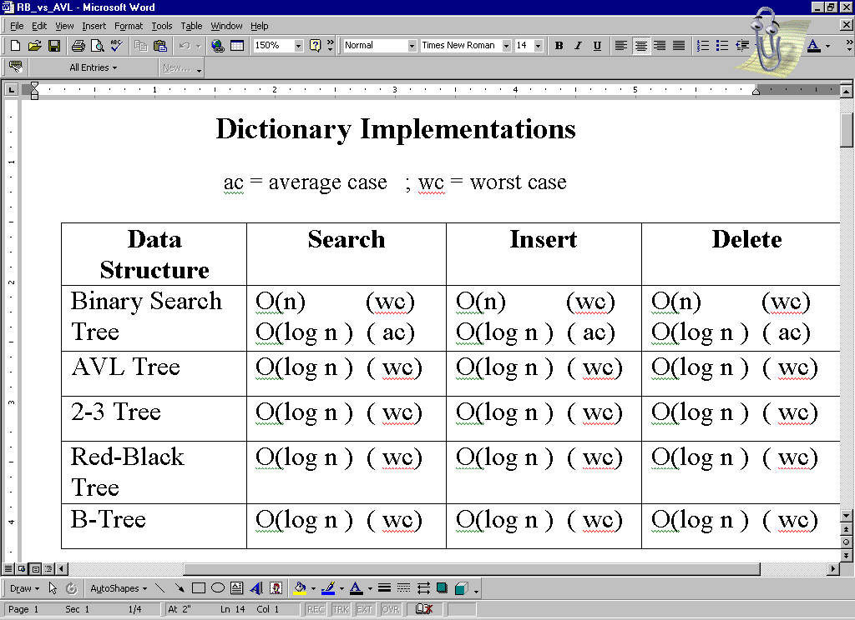

Slide 31
Red-Black Tree Properties
Every node in a red-black tree is either black or red
Every null leaf is black
No path from a leaf to a root can have two consecutive red nodes -- i.e. the children of a red node must be black
Every path from a node, x, to a descendant leaf contains the same number of black nodes -- the “black height” of node x.
newly inserted node

Slide 32
Graph Algorithms
Chapter 22
DFS/BFS Traversals, Topological Sort

Slide 33
Topics
Graph Algorithms: Chapter 22
  Undirected, Directed Graphs
  Connected Components of an Undirected Graph
  Representations: Adjacency Matrix, Adjacency List
  Traversals: DFS and BFS
    Differences in approach: DFS: LIFO/stack vs. BFS:FIFO/queue
    Forest of spanning trees
    Vertex coloring, Edge classification: tree, back, forward, cross
    Shortest paths (BFS)
  Topological Sort
  Tradeoffs:
    Representation Choice: Adjacency Matrix vs. Adjacency List
    Traversal Choice: DFS or BFS

Slide 34
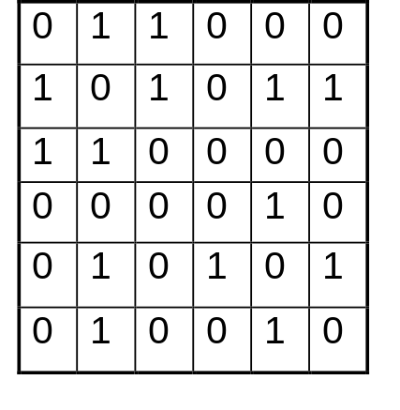
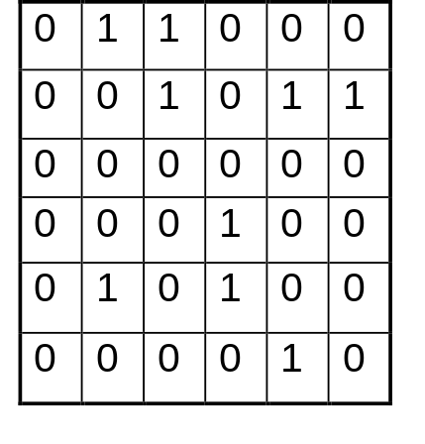
Introductory Graph Concepts:
Representations
Undirected Graph
Directed Graph (digraph)
A
B
A
B
C
C
D
E
F
D
E
F
A B C D E F
A B C D E F
A
B
C
D
E
F
A BC
B ACEF
C AB
D E
E BDF
F BE
A
B
C
D
E
F
A BC
B CEF
C
D D
E BD
F E
Adjacency Matrix
Adjacency List
Adjacency Matrix
Adjacency List

Slide 35
Elementary Graph Algorithms:
SEARCHING: DFS, BFS
  for unweighted directed or undirected graph G=(V,E)
Time: O(|V| + |E|) adj list O(|V|²) adj matrix
  predecessor subgraph = forest of spanning trees
Breadth-First-Search (BFS):
BFS ➔ vertices close to v are visited before those further away ➔ FIFO structure ➔ queue data structure
Shortest Path Distance
  From source to each reachable vertex
  Record during traversal
  Foundation of many “shortest path” algorithms
Depth-First-Search (DFS):
DFS backtracks ➔ visit most recently discovered vertex ➔ LIFO structure ➔ stack data structure
Encountering, finishing times: “well-formed” nested (( )( ) ) structure
DFS of undirected graph produces only back edges or tree edges
Directed graph is acyclic if and only if DFS yields no back edges
  Vertex color shows status:
not yet encountered
encountered, but not yet finished
finished
See DFS, BFS Handout for PseudoCode

Slide 36
Elementary Graph Algorithms:
DFS, BFS
Review problem: TRUE or FALSE?
  The tree shown below on the right can be a DFS tree for some adjacency list representation of the graph shown below on the left.
A
A
B
Tree Edge
Back
Edge
C
Tree Edge
F
B
Tree Edge
E
Tree Edge
D
E
F
C
Cross Edge
Tree Edge
D

Slide 37
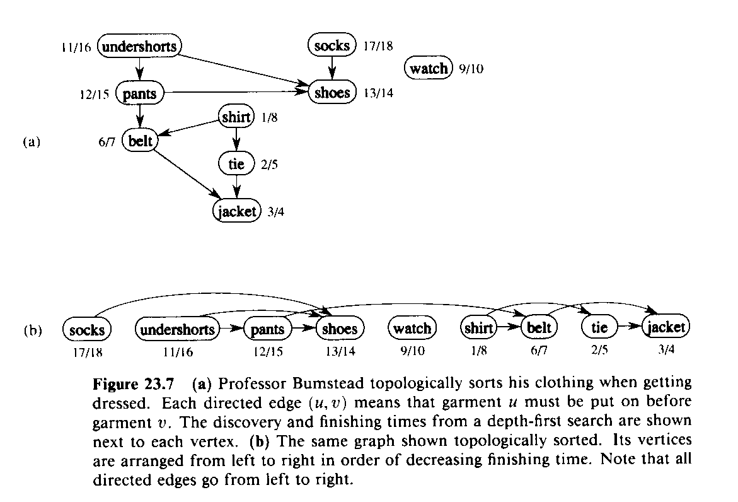
Elementary Graph Algorithms:
Topological Sort
  for Directed, Acyclic Graph (DAG)
  G=(V,E)
TOPOLOGICAL-SORT(G)
1 DFS(G) computes “finishing times” for each vertex
2 as each vertex is finished, insert it onto front of list
3 return list
  Produces linear ordering of vertices.
  For edge (u,v), u is ordered before v.
See also 91.404 DFS/BFS slide show
source: 91.503 textbook Cormen et al.

Slide 38
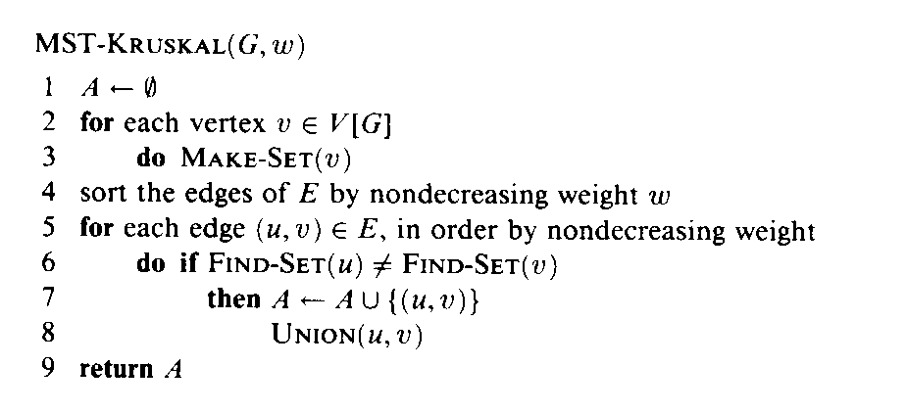
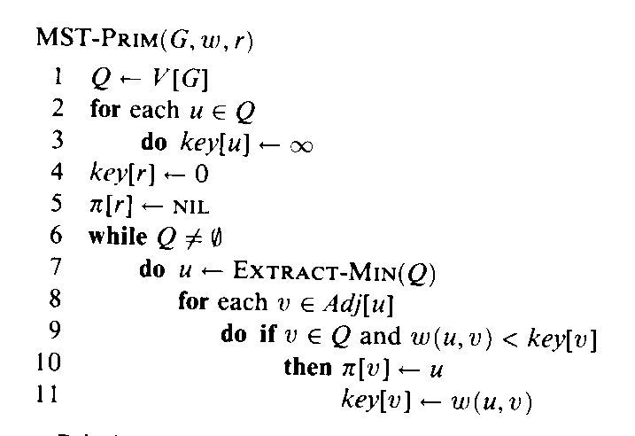
Minimum Spanning Tree:
Greedy Algorithms
Time: O(|E|lg|E|) given fast FIND-SET, UNION
Invariant: Minimum weight spanning forest
  Produces minimum weight tree of edges that includes every vertex.
A
2
4
B
Becomes single tree at end
3
G
5
6
Time: O(|E|lg|V|) = O(|E|lg|E|) slightly faster with fast priority queue
1
E
1
Invariant: Minimum weight tree
7
6
F
8
4
D
C
Spans all vertices at end
2
  for Undirected, Connected, Weighted Graph
  G=(V,E)
source: 91.503 textbook Cormen et al.

Slide 39
Graph Algorithms: Shortest Path
Dijkstra’s algorithm solves this problem efficiently for the case in which all weights are nonnegative (as in the example graph).
Dijkstra’s algorithm maintains a set S of vertices whose final shortest path weights have already been determined.
1
5
10
1
It also maintains, for each vertex v not in S, an upper bound d[v] on the weight of a shortest path from source s to v.
8
3
2
3
4
1
1
1
3
The algorithm repeatedly selects the vertex
u ε V – S with minimum bound d[u], inserts u into S, and relaxes all edges leaving u (determines if passing through u makes it “faster” to get to a vertex adjacent to u).
6
4
6
5
2

